Slide 1

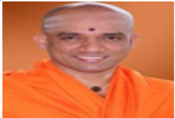
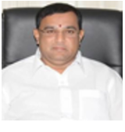

SJB Institute of Technology
Internship Seminar on
“GUI Application to Predict Best Restaurant Using Support Vector Machine Algorithm”
By
B SHAMANTH KOWSHIK [1JB17EC081]
ULLAS GOWDA [1JB17CS056]
Under the guidance of
Mrs. Supriya M, Mrs. Anitha P
Assistant Professors, ECE, SJBIT
Coordinator
Mr. Adithya S K ,
External Guide
Department of Computer Science and Engineering
SJB Institute of Technology
#67, BGS Health and Education City,
Dr. Vishnuvardhan Road, Kengeri, Bengaluru-560060

Slide 2
CONTENTS
Overview of Internship Work
About the company
Introduction
Problem Statement
Methodology
Implementation
Internship Impact
Conclusion

Slide 3
Overview Of Internship Work
To predict the best restaurant in Bengaluru City using Zomato dataset provided in Kaggle Website.
Worked on Experience in the field of Machine Learning and AI.
Hands on Experience on application software such as google collab Notebook, PyCharm etc.
Make use of Python and various ML and data science libraries.
To get Knowledge of various ML algorithms and its real time examples.

Slide 4
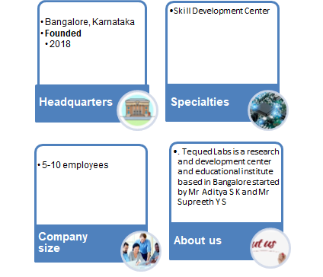
About The Company
Tequed Labs has founded in the year 2018,in Bangalore ,focusing on providing quality education on latest technologies and develop products which are of great need to the society.
They run a project consultancy where they undertake various projects from wide range of companies and assist them technically and build products and provide services to them.
They have different certification , internship courses that helps to build popular projects
Tequed Labs providing working opportunities to various students

Slide 5
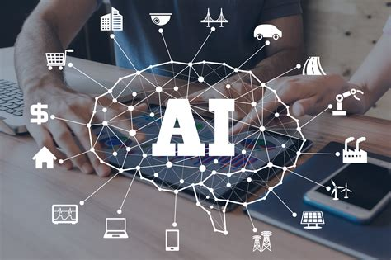
Introduction What Is AI and Machine Learning?
The science and engineering of making intelligent machines, especially intelligent computer programs. It is related to the similar task of using computers to understand human intelligence.
Machine learning is a branch of Artificial Intelligence and computer science which focuses on the use of data and algorithms to imitate the way that humans learn, gradually improving its accuracy.
The field is becoming increasingly significant due to the increased reliance on computer systems.

Slide 6

Why Machine Learning?
ML is the latest and most demanding technology in present world.
The Machine Learning technology can be important for companies that are doing enhancements and implementations from their competitive companies using their customer’s data. In today’s world, if any business starts and does not use machine learning technology, then its company is incomplete.
Cleaning of data and applying to ML algorithms makes good decisions/predictions than anything.

Slide 7
What is GUI?
GUI is abbreviated as Graphical User Interface.
Its a form of user interface that allows User to Interact with electronic devices through graphical icons,indicators such as primary notation instead text based/command line interface
To create a custom GUI ,we create instances of widgets and layouts.
These widgets have different number of arguments like it allows to create function ,it will performs different actions.

Slide 8
Problem Statement
Prediction of Best restaurant in Bengaluru City using Zomato dataset provided in Kaggle Website.
Graphical User Interface application to analyse and predict restaurant based on location,rating,cuisines and dishes.

Slide 9
METHODOLOGY
Getting the required dataset from the Kaggle in required format i,e .csv
Cleaning of Data using Python Numpy and Pandas module.
Importing required modules to implement the application.
Fitting the Support Vector Machine algorithm by providing the dataset.
Building Graphical User Interface application using TkInter module of python
Prediction of Restaurant based on user wish.

Slide 10
IMPLEMENTATION
For initial dataset -> https://www.kaggle.com/himanshupoddar/zomato-bangalore-restaurants ,provide appropriate path location
2. Installing all required modules to implement the application such as matplotlib, pandas, tkinter and numPy etc.
3. Cleaning of data or taking the required data from the .csv file.
4.GUI application using python requires TKInter module, so we are importing TKInter module and start building main window
5.GuI Application has buttons for particular task, developing the button attribute also requires TKINter as the parent module.

Slide 11
Building the GUI
TKInter is the most commonly used fastest and easiest way to implement GUI application using Python.
Building this application involves importing the TKInter module.
Creating a graphical window using Tkinter.Tk() method.
We added many widgets including buttons ,labels etc to act to a certain action.
Creating widgets and creating functions to add to widgets to perform when the action triggers.
Enter the main event loop, i,e launching the window by running mainloop() function.

Slide 12
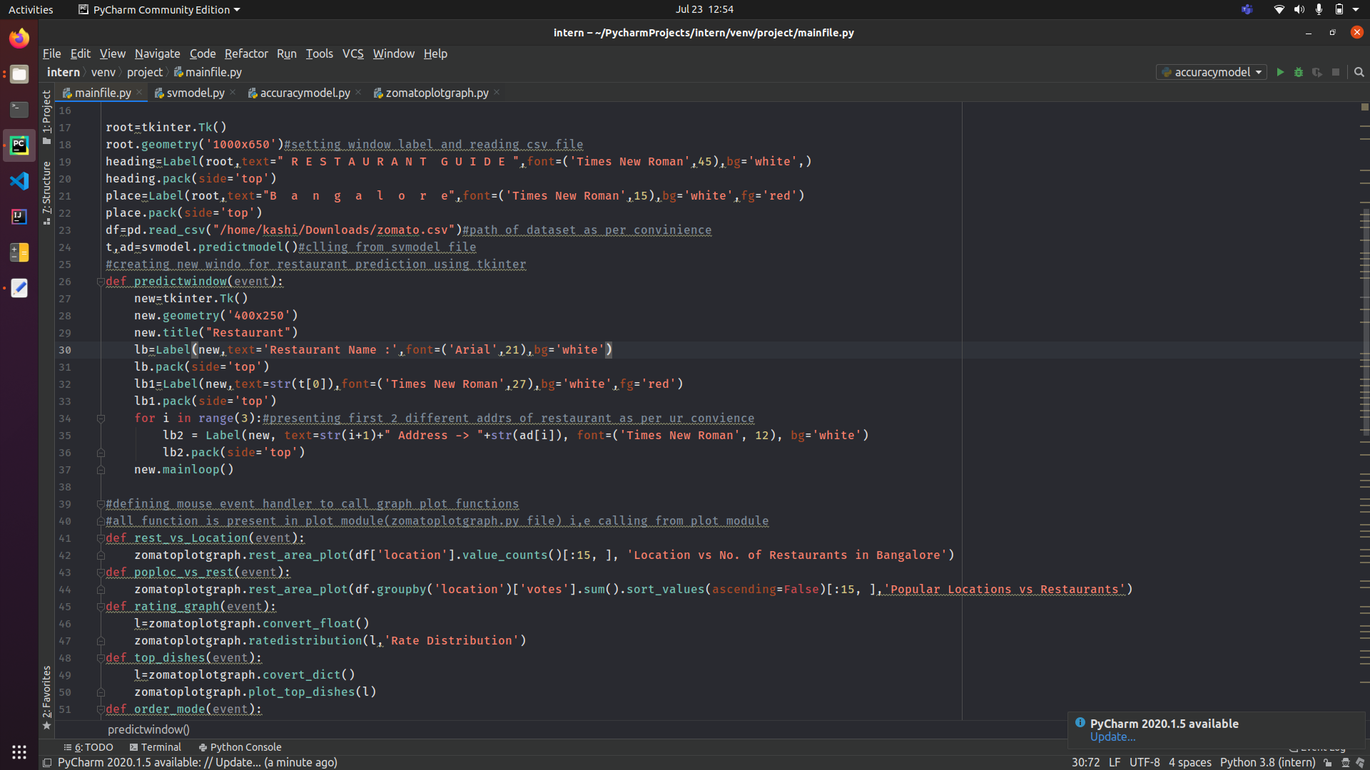
4. Coding part of the main page window

Slide 13
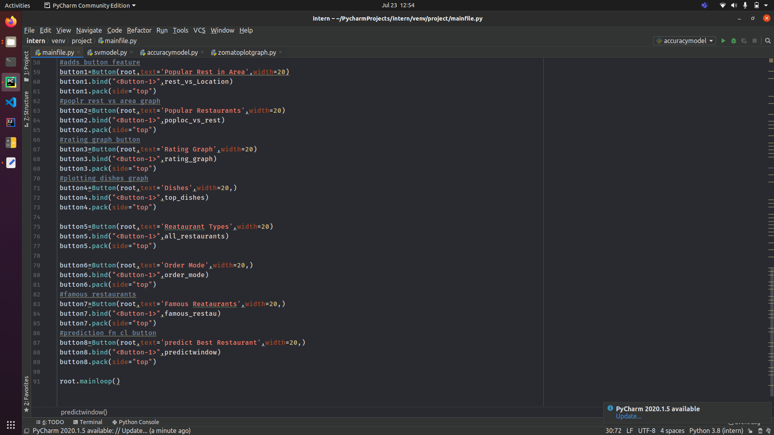
Connecting the algorithm and graphical libraries to the GUI application

Slide 14
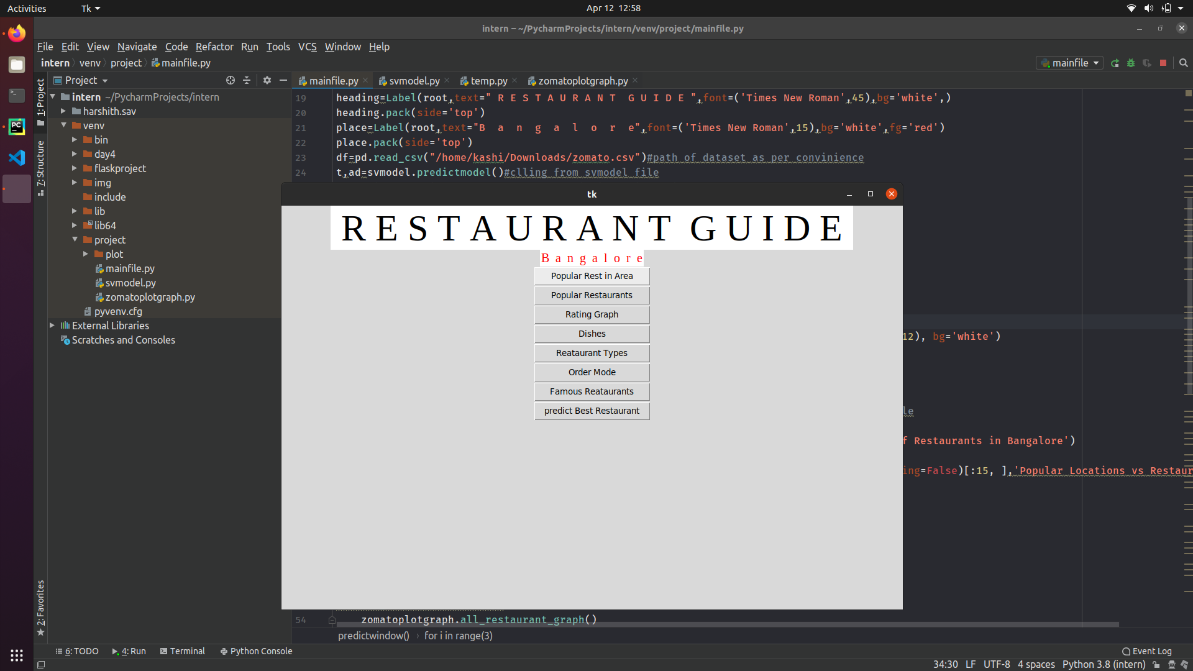
4. Main page Window

Slide 15
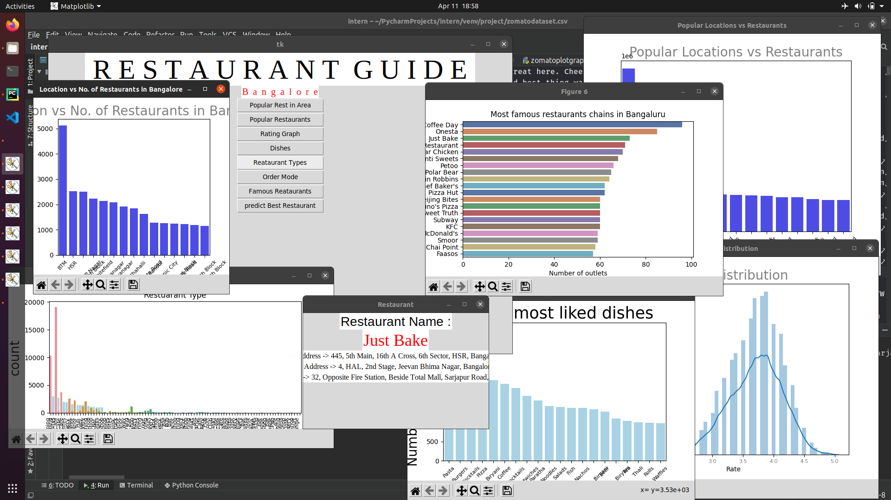
6. Building the graphical representation of restaurants and dishes

Slide 16
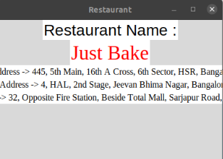
6. Result Window.

Slide 17
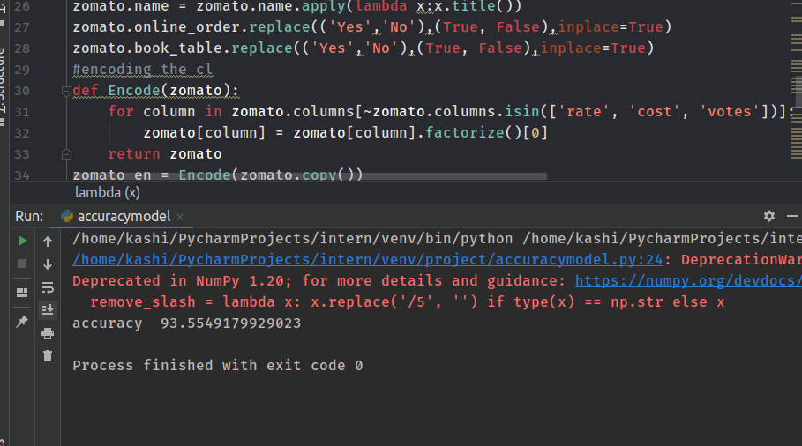
7. Accuracy of the prediction model

Slide 18
Internship Impact
We learnt working in a team and also individual.
Explored career path in AI and ML by developing a real world application.
Learnt new skills in AI,ML and data science fields ,which boosts the knowledge in the field.
Helped in self development and boosts knowledge.

Slide 19
CONCLUSION
Lightweight ,fast and more accurate prediction using Machine Learning Algorithm.
Since it needs to fit the model by providing the data ,takes time to fit.
Python gives extraordinary modules such as pandas,matplotlib etc helping in data cleaning and graphical application.
Prediction of Restaurant based on cuisines,location,Price and location.
A Graphical UI based window is launched ,hence it is flexible and user friendly.
Generation of statistical graph of Restaurant,Ratings etc.
Users have different options to look into restaurants,cuisines,locations,ratings.

Slide 20
THANK YOU

